Slide 1
Lecture 15: fluency

Slide 2
Behavioral fluency
Binder (1996)
Defined as combination of response accuracy & response rate
Combines accuracy & speed of response that enables individuals to demonstrate a skill efficiently & effectively
Fluency
Teaching model that teaches specific elements of behavior over & until the behavior becomes fluent

Slide 3
Behavioral fluency
Precisions teaching
Free-operant conditioning teaching model
Provides opportunity for learners to make weekly learning improvement decisions from self-charted & error performance frequencies on standard change charts
Repeated daily one-minute timings build fluency
Fluent performance builds retention, endurance, application

Slide 4
Standard celeration chart (SCC)
Developed by Ogden Lindsley in 1965
Displays frequency against continuous real-time line
Provides a graphic means of displaying celeration
Celeration
Change in frequency over time
A universal measure of frequency change over time, giving a quantitative description of human behavior change (Calkin 2005)

Slide 5
Standard celeration chart (SCC)
Celeration
Acceleration
Change is positive
Deceleration
Change is decreasing

Slide 6
Standard celeration chart (scc)
4 different types of charts
Daily (most often used)
Weekly
Monthly
Yearly

Slide 7
Standard cEleration Chart (SCC)
SCC can tell us information on performance over time
Depending on which chart is used, it will determine how efficient and fluent someone performs on a particular skill

Slide 8


How to use the scc chart

Slide 9
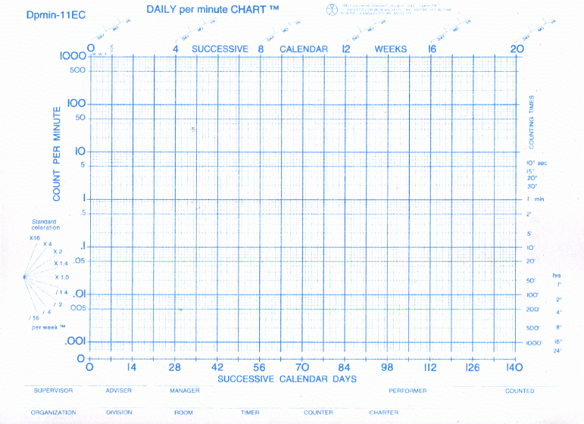

Slide 10
SCC Symbols
“A” –Aims
This is the goal you are going to set for yourself
If you are looking to decrease or “decelerate” a frequency you denote this with an upside down “A”
“x”-Errors
You will place an “x” to represent the number of errors you make during your timings
“.”-Correct
You will place a “.” to represent the number of correct responses you made during your timings

Slide 11
SCC Symbols
On “No Chance” days you will not connect any “.” or “x” to denote there were no opportunities to collect data
The Record Floor
Lowest possible non-zero result of the assessment
Serves as a reminder of what results are possible
Remains constant
Formula: 1/counting time in minutes
Denoted with “_”

Slide 12
SCC Symbols
The Record Ceiling
Highest possible result of an assessment
Serves as a reminder of what results are possible
Remains constant
Formula: highest possible count/assessment time
Denoted with a “-”
NOTE: Try to avoid record ceilings
Provide more opportunities to demonstrate a behavior

Slide 13
How does This work?

Slide 14
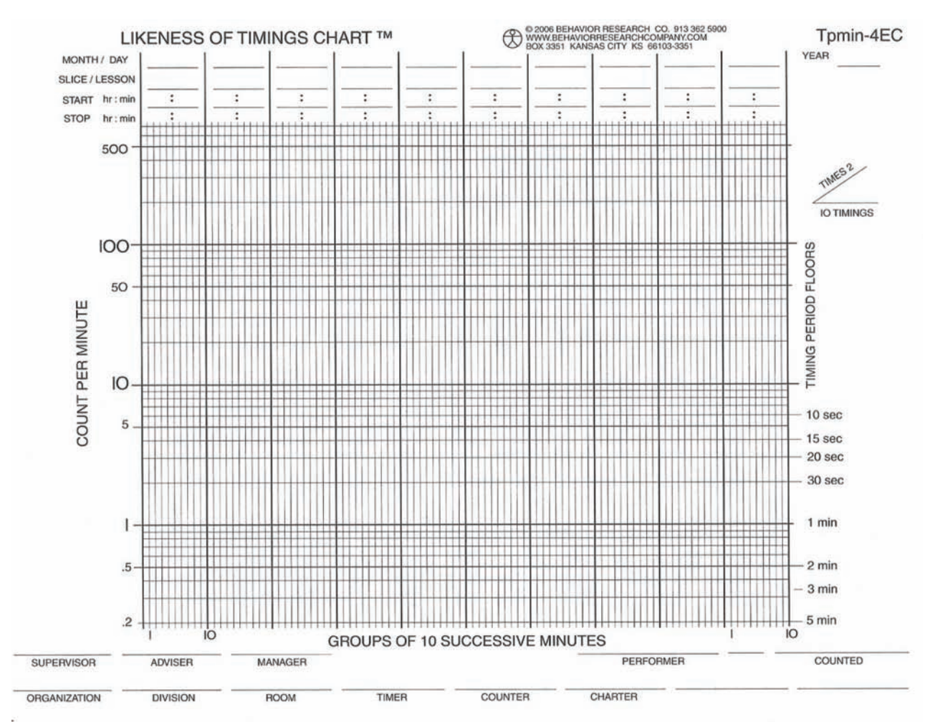

Slide 15
SCC Symbols
Slice/Lesson
“See-Say” or “Say-See”
Set number
Separate lessons by whether or not you are seeing the definition/saying the term or saying the definition when seeing the term

Slide 16
Start Time: |  | End Time
Minute | Correct |  | Errors
1
2
3
4
5
6
7
8
9
10

